Slide 1

Automated Essay Scoring with LSTM Networks
Bhaskar Vora (235819680)
Raj Sangani (235828600)

Slide 2
Why automated essay scoring?
Traditional grading is slow and subjective.
Automated scoring offers faster turnaround, reduce bias, and provides valuable data for educators.
This technology can improve efficiency and student learning outcomes.

Slide 3

Unlocking Sequence Power: LSTM Networks for Essay Scoring
LSTMs (Long Short-Term Memory) networks are a type of recurrent neural network (RNN) architecture.
Unlike standard RNNs, LSTMs can learn from long sequences of data by addressing vanishing gradient problems.
This makes them ideal for tasks like automated essay scoring, where understanding the context of words across sentences is crucial.

Slide 4
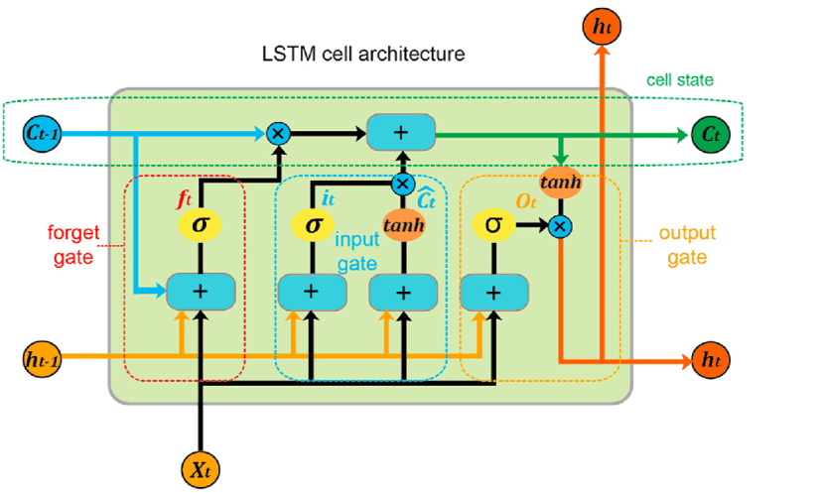
Choosing the Right Tool: LSTM vs BERT
Both LSTM and BERT are powerful for NLP tasks.
LSTMs: Simpler, efficient for long-term dependencies in sequences.
We choose LSTMs for:
LSTM excels in tasks requiring sequential understanding, such as analyzing essay flow, which is crucial in automated essay scoring.
Good accuracy/efficiency balance for essay scoring.
In resource-constrained scenarios, LSTM's lighter architecture outperforms BERT.
LSTM captures nuanced relationships within essays better than BERT.
LSTM offers better interpretability, aiding scoring transparency.

Slide 5

Our Training Ground: The Hewlett Foundation Essay Scoring Dataset
To train our automated essay scoring model, we'll leverage a valuable dataset from the Hewlett Foundation.
This dataset consists of student-written essays on various topics, accompanied by human expert scores.
The essays cover a range of grade levels and writing styles, providing a comprehensive training ground for our LSTM model.
Key Dataset Columns:
essay_id: Unique identifier for each individual student essay.
essay_set: Identification number for each set of essays.
essay: ASCII text of the student's response.
domain1_score: Resolved score between the raters for each essay.

Slide 6
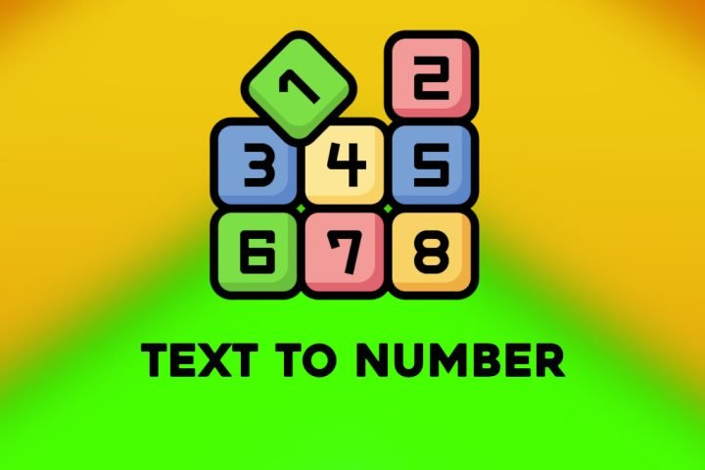
Transforming text to numbers (Preprocessing data)

Slide 7
Cleaning and tokenization
We'll remove punctuation and special characters, to focus on the core content.
We'll then split the essays into individual words, the building blocks the LSTM understands.
Then, we will remove common words like "the" and "a" (stop words) that don't carry much meaning.

Slide 8
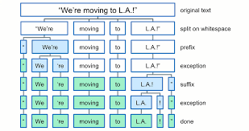
Sentence Tokenization
We'll further segment the essays into individual sentences. This allows the LSTM to potentially analyze the flow of ideas within the essay.

Slide 9

Feature Vector Creation (Google News 300):
Here, we leverage the power of the Google News 300 model, a pre-trained word embedding model.
This model assigns a unique 300-dimensional numerical vector to each word, capturing its meaning and relationship with other words based on a massive dataset of news articles.
Imagine a dictionary where each word has a 300-dimensional code representing its meaning and connection to other words.
We can then convert each sentence into a single feature vector by averaging the word vectors within that sentence. This feature vector becomes a numerical summary of the sentence's meaning, enriched by the context captured in the Google News 300 model.

Slide 10
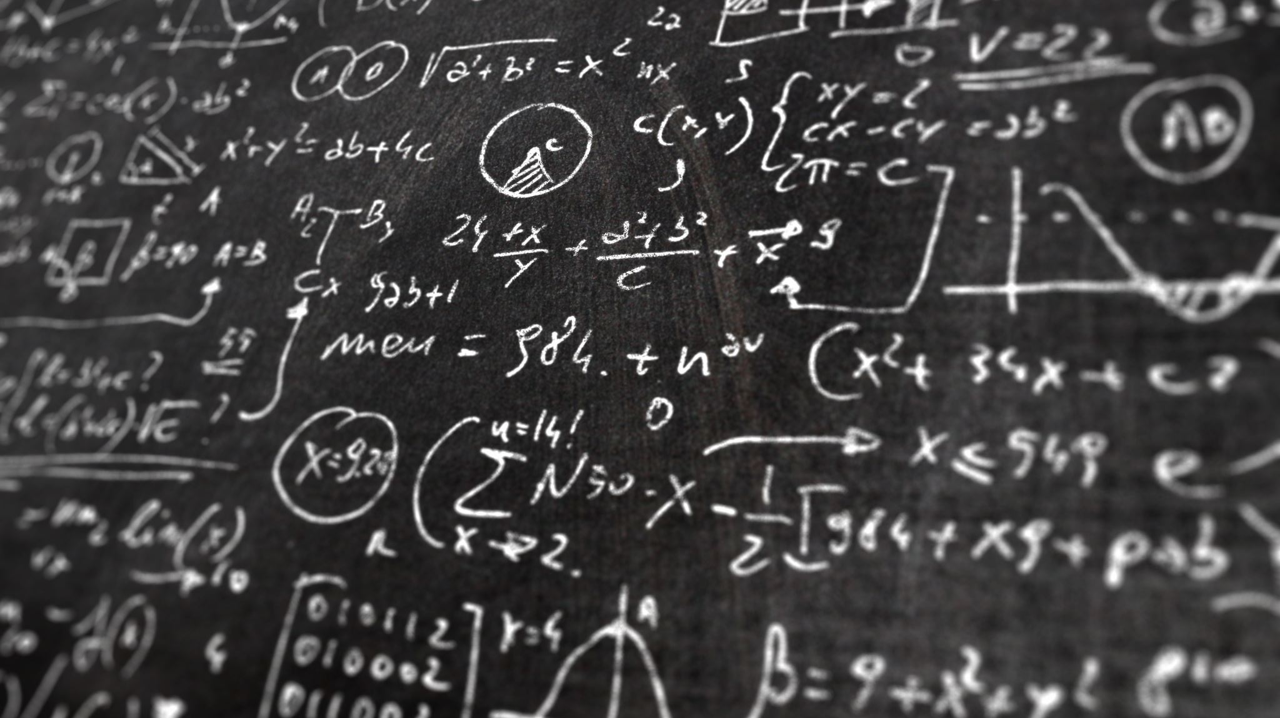
Unleashing the Power: Training the LSTM for Essay Analysis
We've preprocessed the essays and transformed them into feature vectors. Now, it's time to train our LSTM model!

Slide 11

Training Process: K-Fold Cross validation
The code utilizes K-Fold cross-validation to evaluate the model's performance more robustly.
The data is split into 5 folds (groups). In each fold:
A portion of the data is used for training (training set).
Another portion is used for validation during training (validation set).
The remaining unseen portion is used for testing after training (test set)
In each fold, a new LSTM model instance is created.
The model is trained on the training data vectors and their corresponding target values for a specified number of epochs

Slide 12
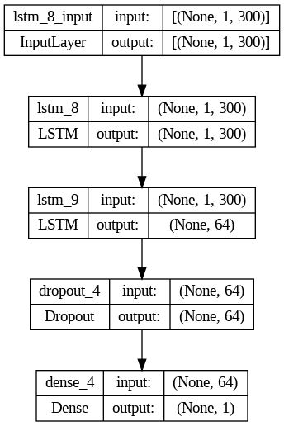
Model Architecture:
The figure defines a Sequential model architecture with LSTM layers.
The first LSTM layer has 300 hidden units (matching the feature vector size).
The second LSTM layer has 64 hidden units and recurrent dropout for regularization (preventing overfitting).
A Dense layer with 1 unit and ReLU activation predicts the target value.

Slide 13
COhen's Kappa score :is a statistic that is used to measure inter-rater reliability (and also intra-rater reliability) for qualitative (categorical) items. < 0: No agreement
0-0.20: Slight agreement
0.21-0.40: Fair agreement
0.41-0.60: Moderate agreement
0.61-0.80: Substantial agreement
0.81-1: Almost perfect agreement

Slide 14
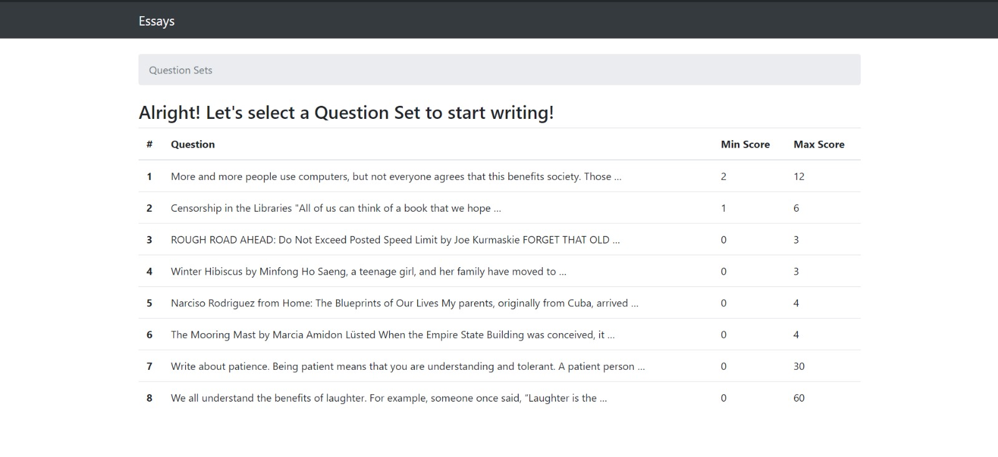
Question setS

Slide 15

PRompt to answer questions

Slide 16
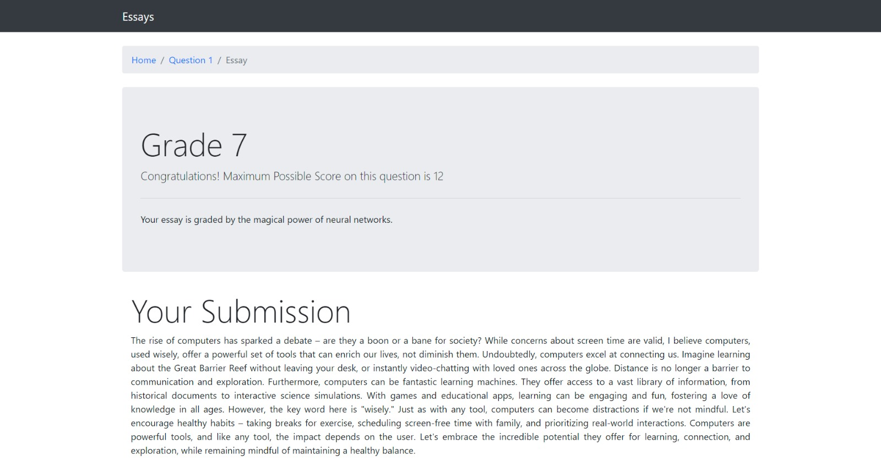
GRaded result in real world scenario

Slide 17
Future enhancements
Implement the model on LMS (Learning Management System)
Use of ensemble method to mitigate the risk of overfitting

Slide 18
REFERENCES
A Neural Approach to Automated Essay Scoring Kaveh Taghipour and Hwee Tou Ng Department of Computer Science National University of Singapore
Automatic Text Scoring Using Neural Networks from University of Cambridge

